Slide 1
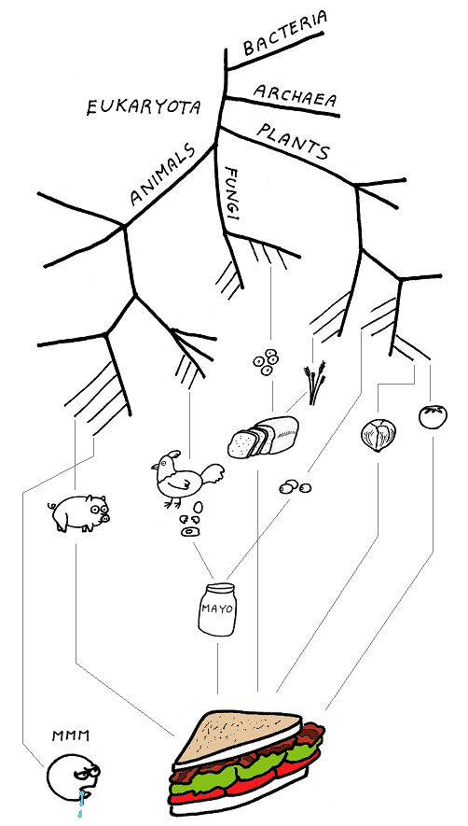
The Population Genetics of Stress-Induced Mutagenesis
Yoav Ram
Hadany Lab
Tel-Aviv University
26 June 2015

Slide 2



Variability in mutation rates
Between species
Rates are in average number of measurable mutations per genome per generation
Flies: 0.455
Keightley et al. Gen Res 2009
Humans: 41
Lynch, PNAS 2010
Bacteria: 0.0004
Wielgoss et al. G3 2011

Slide 3
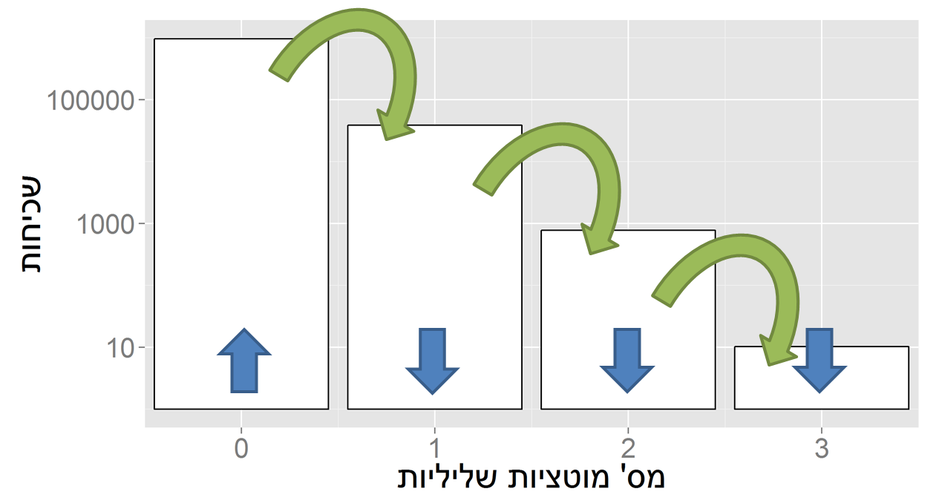
Evolution in a static environment
Directional selection without change
A balance between mutation and natural selection
Frequency
# Deleterious mutations

Slide 4
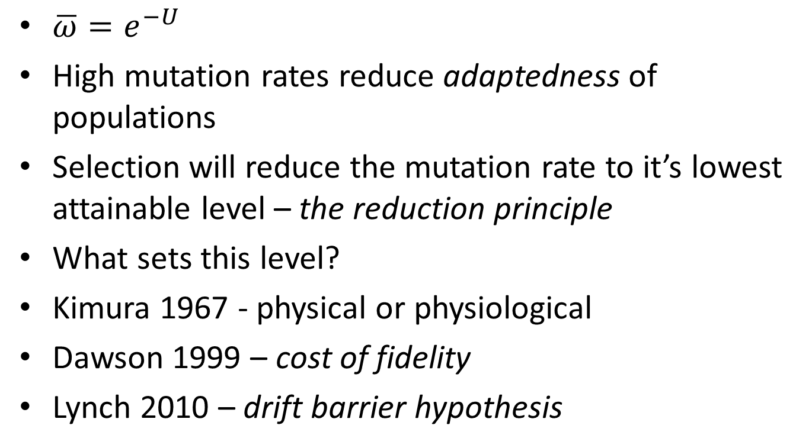
Mutation rate in static environments
$\overline{ω}=e^{−U}$
High mutation rates reduce adaptedness of populations
Selection will reduce the mutation rate to it’s lowest attainable level – the reduction principle
What sets this level?
Kimura 1967 - physical or physiological
Dawson 1999 – cost of fidelity
Lynch 2010 – drift barrier hypothesis

Slide 5
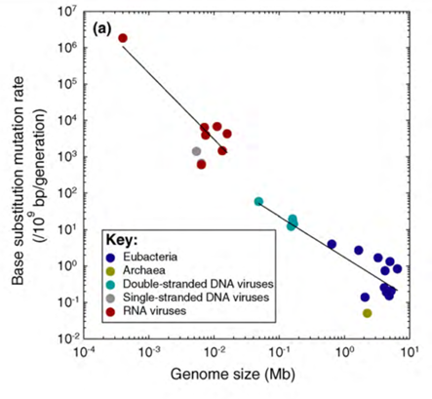
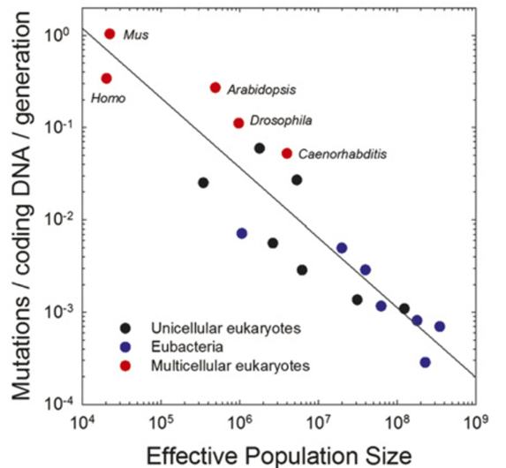
Non-adaptive hypotheses
Genome size (Mb)
Effective population size
Sung et al. PNAS 2012

Slide 6

Evolution in a dynamic environment
In changing environments rapid adaptation can be favored by natural selection (adaptability)
The mutation rate must balance between adaptability and adaptedness

Slide 7

Variability in mutation rates
Within species
Mutation rate in 69 natural populations of E. coli Matic et al. 1997

Slide 8
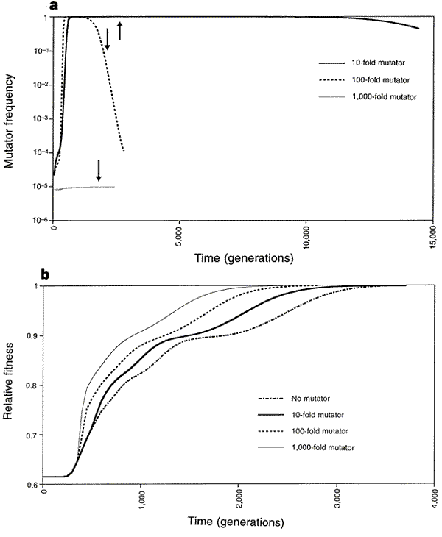
Adaptation with mutator alleles
x100
x10
x1
x1,000
Taddei, et al. Nature 1997

Slide 9
Rise and fall of the mutator allele
x10
x100
x1,000
Taddei, et al. Nature 1997
Notes:
An arrow symbolizes the time when population fitness has reached 0.99

Slide 10

Variability in mutation rates
Within individuals
DNA polymerase error rate Lynch 2011

Slide 11

Stress-induced mutation
Rosenberg et al. 2012
In E. coli:
Error prone polymerase induced by stress responses:
SOS response
DNA damage
Starvation
Mismatch repair system
Other mechanisms:
Galhardo et al. 2007
Al Mamun, Science 2012

Slide 12

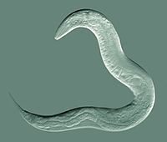
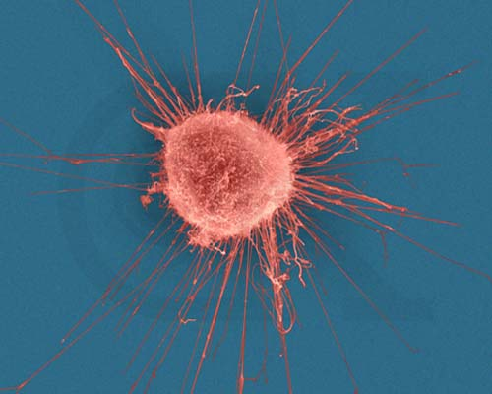



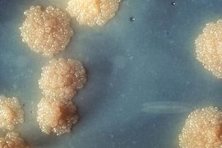

Evidence
Green algea
Nematodes
E. coli
Bacillus subtilis
Breast cancer cell
D. Melanogaster
M. tuberculosis
L. monocytogenes

Slide 13

Evolution of stress-induced mutation
Null hypothesis
Mutagenesis is the by-product of stress
Alternative non-adaptive hypotheses
Cost of fidelity
Drift barrier hypothesis
Adaptive hypothesis
Second order selection

Slide 14
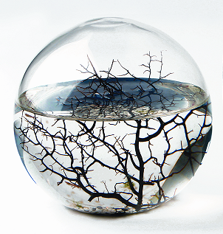
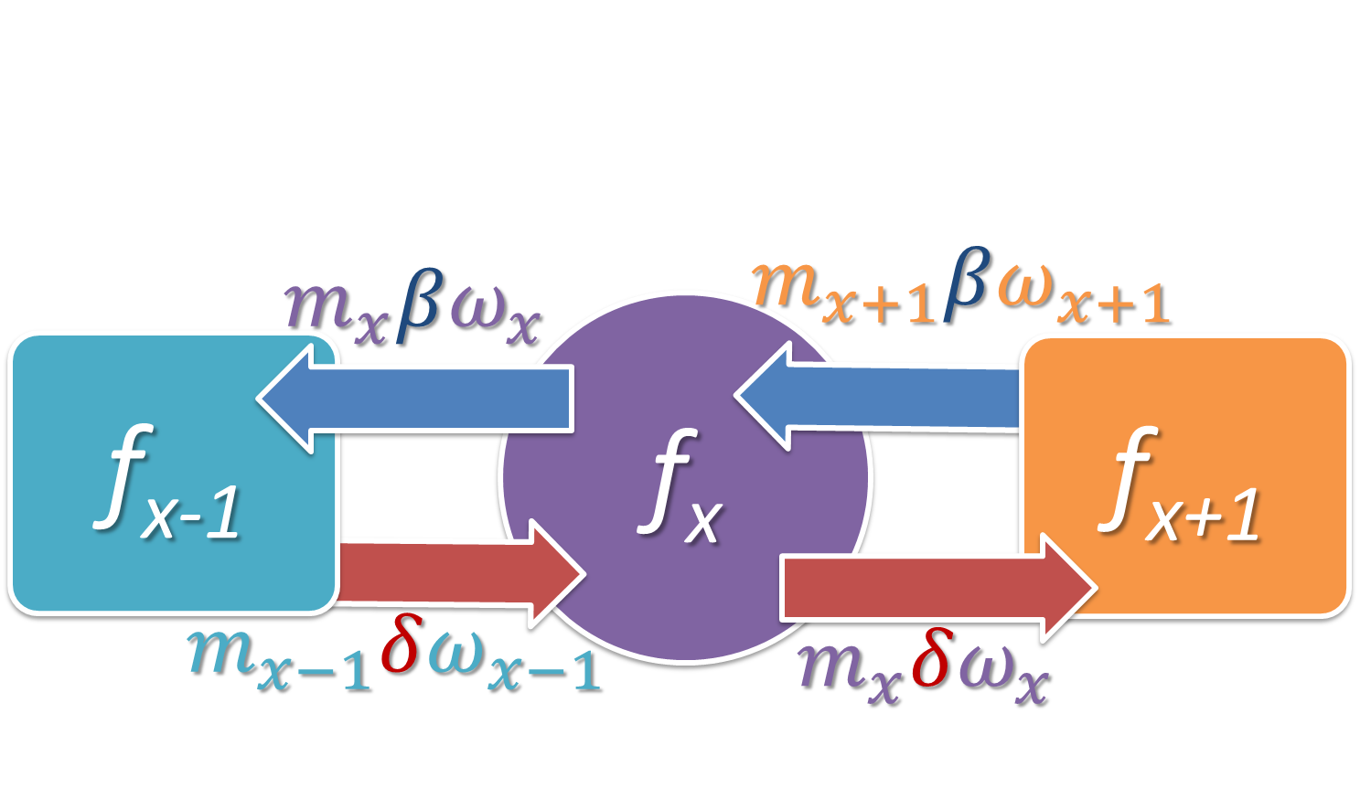
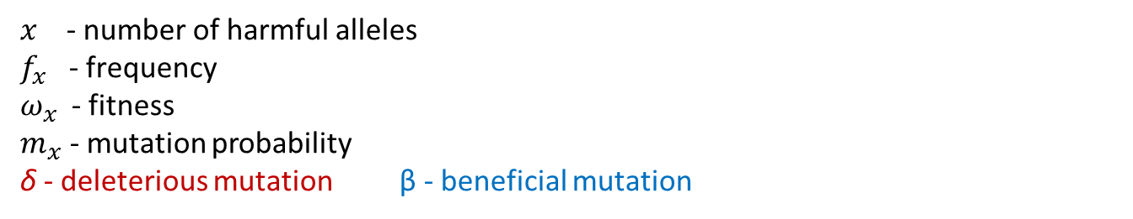
Static environment
Selection against generation of deleterious mutations
$x$ - number of harmful alleles
$f_{x}$ - frequency
$ω_{x}$ - fitness
$m_{x}$ - mutation probability
δ - deleterious mutation β - beneficial mutation
Ram & Hadany, Evolution 2012

Slide 15
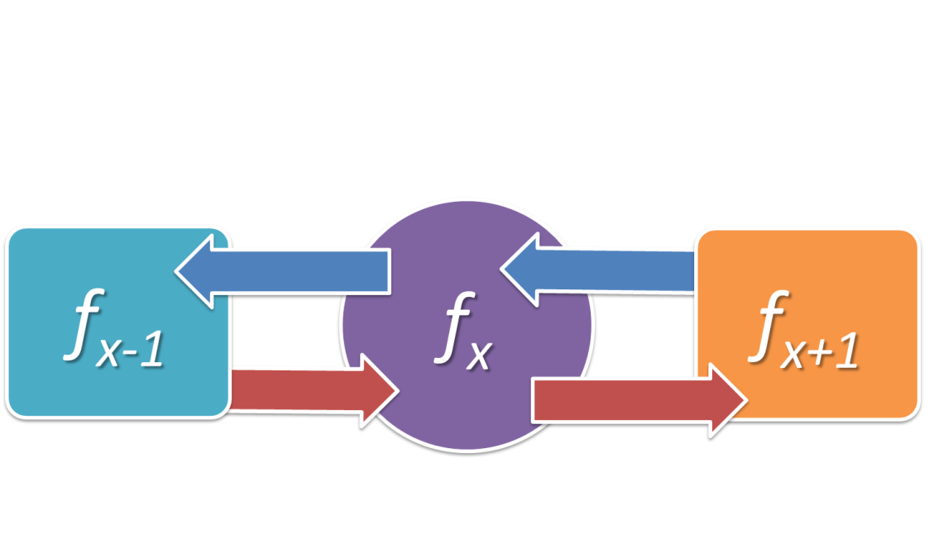
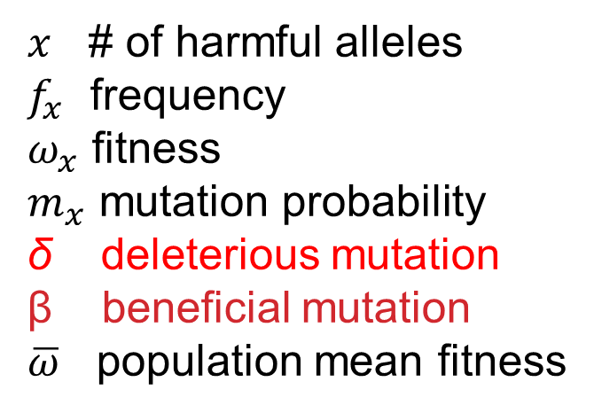
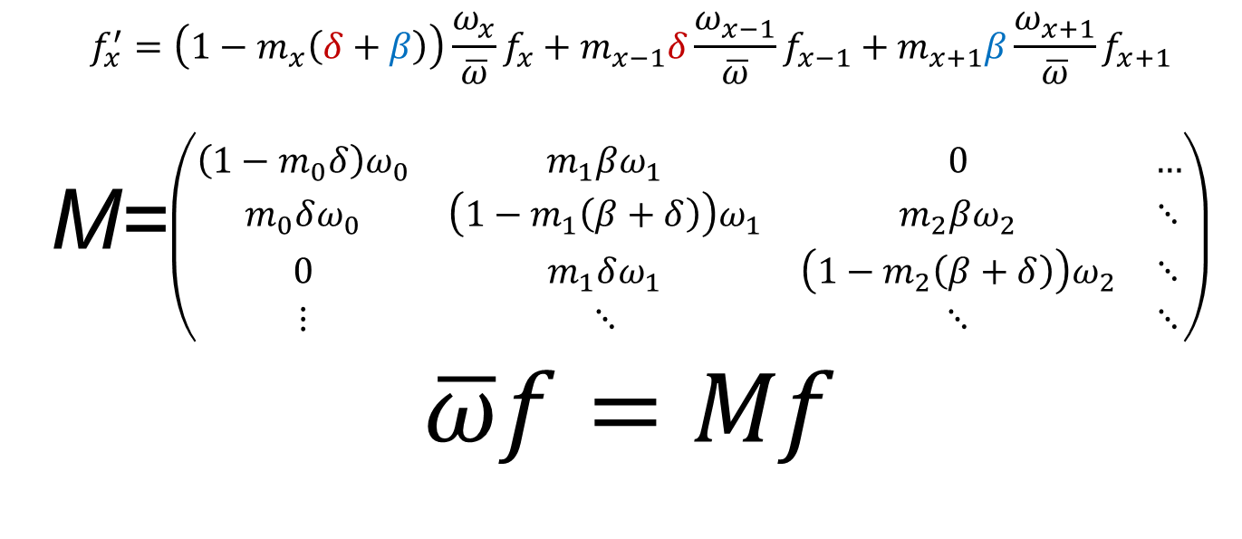
$x$ # of harmful alleles
$f_{x}$ frequency
$ω_{x}$ fitness
$m_{x}$ mutation probability
δ deleterious mutation
β beneficial mutation
$\overline{ω}$ population mean fitness
$$f_{x}^{′}=\left(1−m_{x}\left(δ+β\right)\right)\frac{ω_{x}}{\overline{ω}}f_{x}+m_{x−1}δ\frac{ω_{x−1}}{\overline{ω}}f_{x−1}+m_{x+1}β\frac{ω_{x+1}}{\overline{ω}}f_{x+1}$$
M=$\left(\begin{matrix}\left(1−m_{0}δ\right)ω_{0} & m_{1}βω_{1} & 0 & … \\ m_{0}δω_{0} & \left(1−m_{1}\left(β+δ\right)\right)ω_{1} & m_{2}βω_{2} & ⋱ \\ 0 & m_{1}δω_{1} & \left(1−m_{2}\left(β+δ\right)\right)ω_{2} & ⋱ \\ ⋮ & ⋱ & ⋱ & ⋱\end{matrix}\right)$
$$\overline{ω}f=Mf$$
Ram & Hadany, Evolution 2012

Slide 16
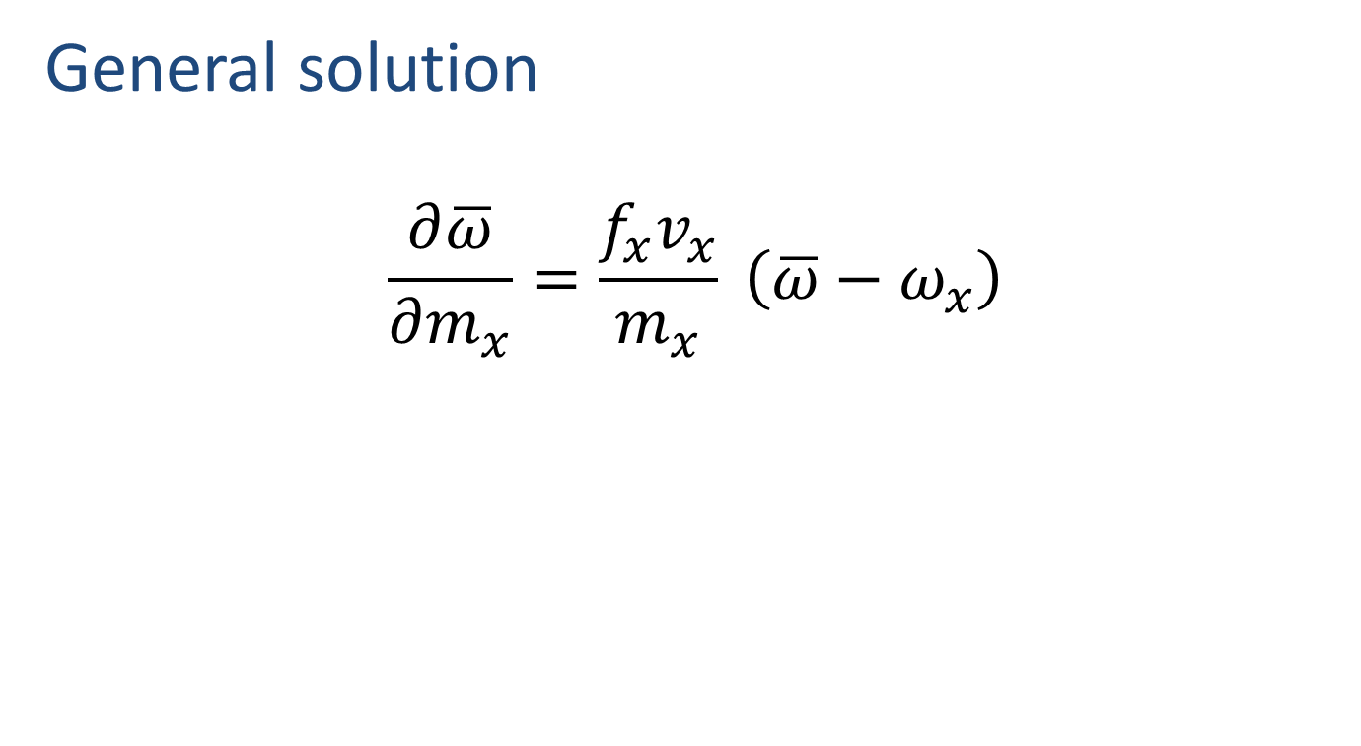
Static environment
General solution
$$\frac{∂\overline{ω}}{∂m_{x}}=\frac{f_{x}v_{x}}{m_{x}} \left(\overline{ω}−ω_{x}\right)$$
Ram & Hadany, Evolution 2012

Slide 17
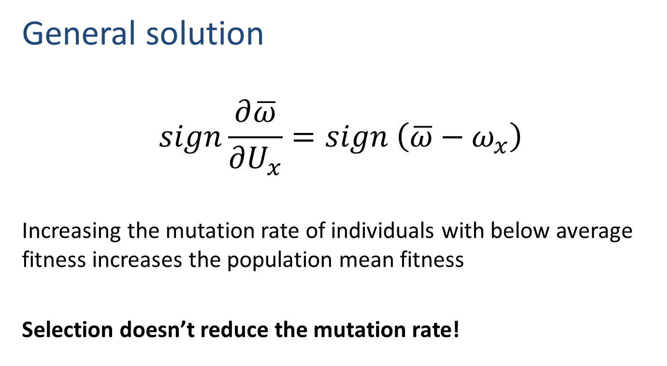
Static environment
General solution
$$sign\frac{∂\overline{ω}}{∂U_{x}}=sign \left(\overline{ω}−ω_{x}\right)$$
Increasing the mutation rate of individuals with below average fitness increases the population mean fitness
Selection doesn’t reduce the mutation rate!
Ram & Hadany, Evolution 2012

Slide 18

Static environments
Constitutive mutator (CM)
Ram & Hadany, Evolution 2012

Slide 19

Static environments
Stress-induced mutator (SIM)
Ram & Hadany, Evolution 2012

Slide 20

Rapidly changing environments
The Red Queen hypothesis (van Valen, 1973):
It takes all the running you can do, to keep in the same place.
- Lewis Carrol, Through the Looking Glass
What happens when the environment changes frequently?

Slide 21

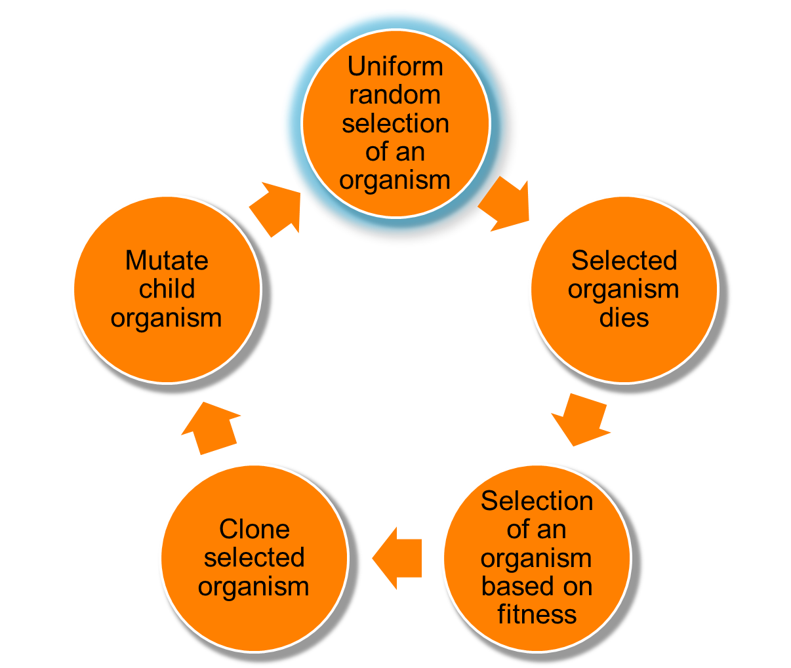
Changing environments
https://github.com/yoavram/proevolutionsimulation
Simulations
Moran process
Individual-based simulations
100,000 individuals
1,000 loci
Asexual, Haploid
Overlapping generations
No recombination
No segregation
No mutations at mutator locus
Environmental changes
Ram & Hadany, Evolution 2012

Slide 22
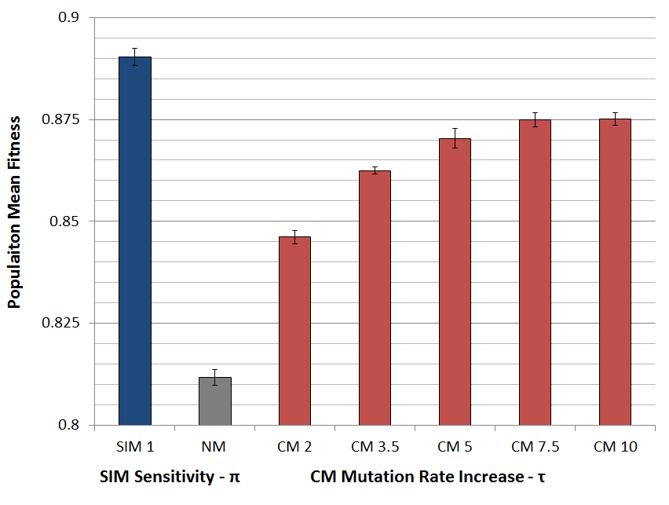
Populations with SIM are fitter
Ram & Hadany, Evolution 2012

Slide 23

SIM wins competitions
Ram & Hadany, Evolution 2012

Slide 24

SIM wins competitions
Ram & Hadany, Evolution 2012

Slide 25
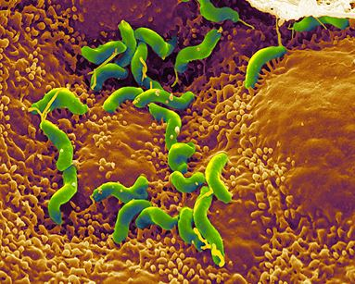
Summary: evolution of stress-induced mutation
Stress-induced mutators evolve:
In finite & infinite populations
In constant & changing environments
2nd order selection can lead to the evolution of stress-induced mutagenesis in asexual populations
Selection for evolvability
H. pylori

Slide 26
Consequences of stress-induced mutagenesis
How does stress-induced mutagenesis
affect evolution?

Slide 27
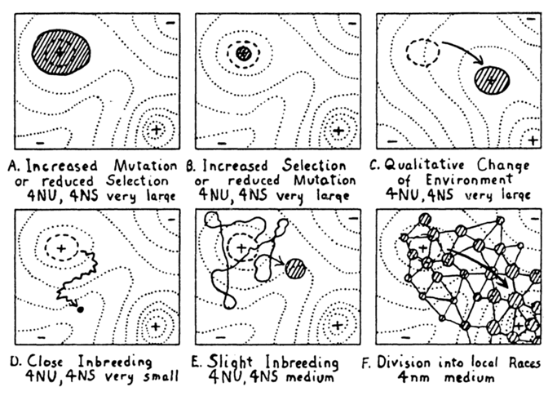
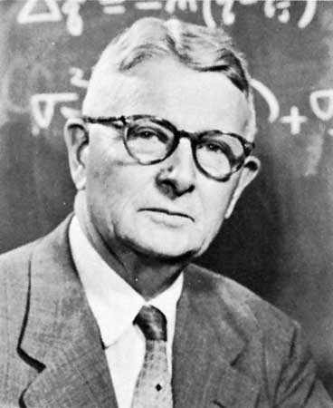
Adaptive peak shifts
Sewall Wright, 1931:
If a new adaptation requires several, separately deleterious mutations, how can it evolve?
Wright, Am. Nat. 1988

Slide 28
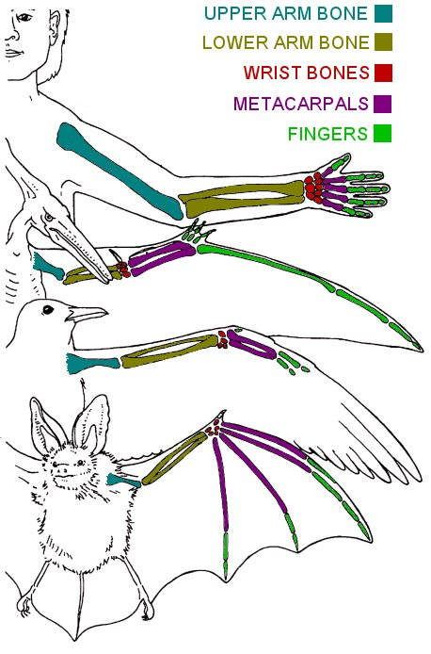
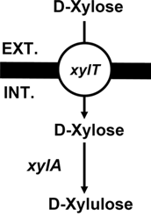
Examples
Criteria
Adaptation requires a change in two or more traits
Change in only one trait causes reduced fitness
Wings and bones
Flying with heavy bones is costly
Walking and climbing with light bones is dangerous
New metabolic pathway
Two new proteins required – pump and enzyme
each is wasteful without the other
Adaptation to high UV (Haldane 1932, p. 175)
Dark skin – increased pigmentation
Vitamin D storage in the liver
Xiao et al. 2011

Slide 29
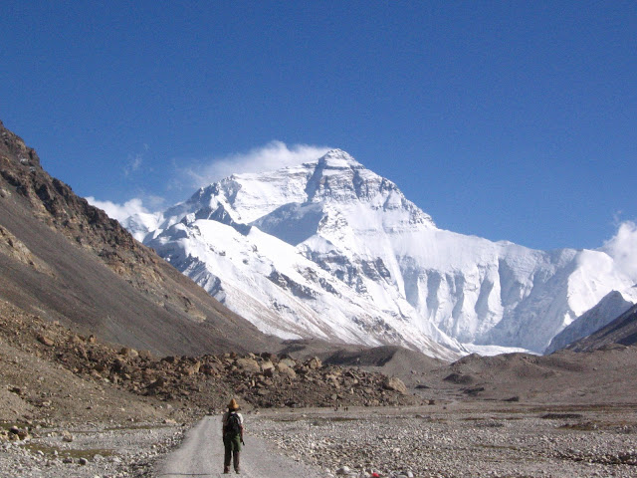
Simple landscape

Slide 30
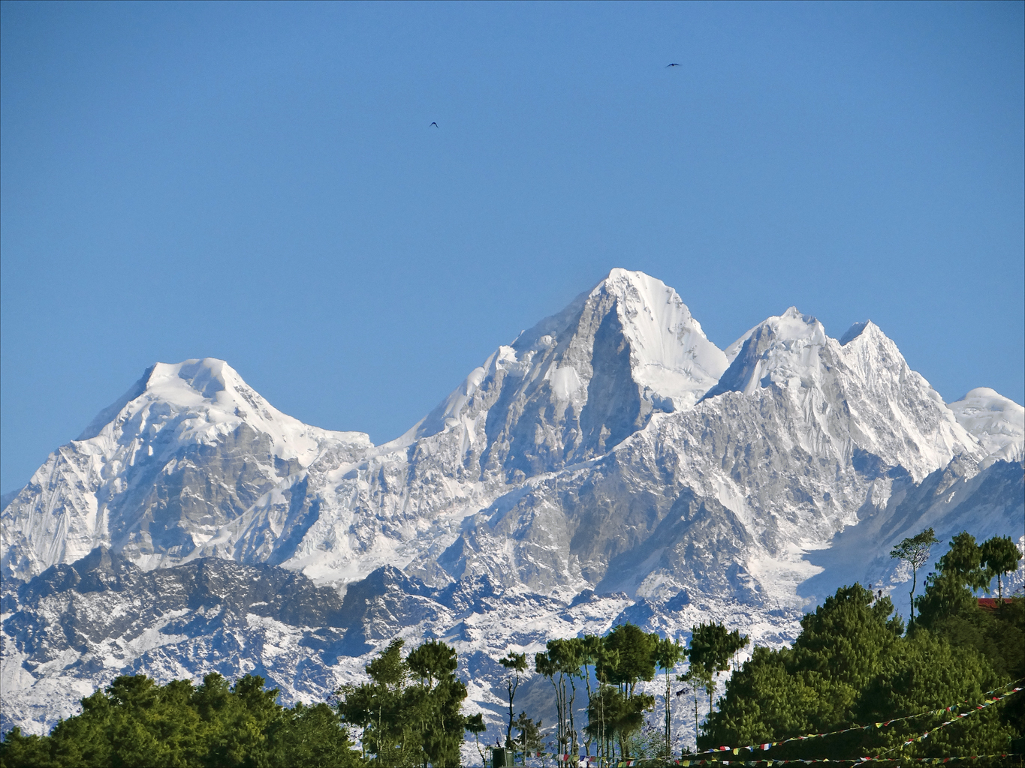
Rugged landscape

Slide 31
SIM & rugged landscapes
Increasing the mutation rate in individuals below both peaks
High mutation rate
Low mutation rate

Slide 32
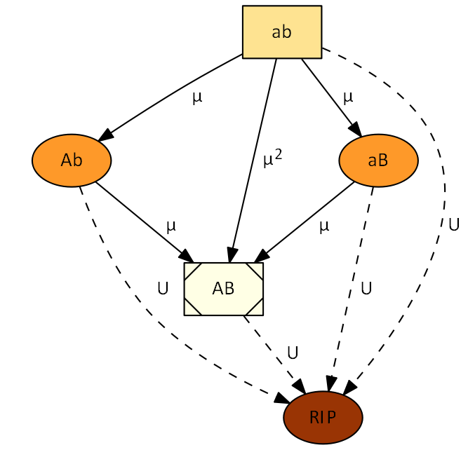
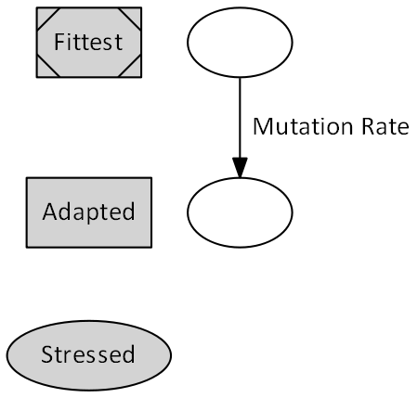


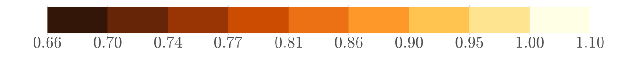
Deterministic model
fitness
Ram & Hadany, PRSB 2014

Slide 33
Deterministic model
The adaptation process is composed of
Waiting for double mutant
Fixation / extinction of double mutant
Ram & Hadany, PRSB 2014

Slide 34
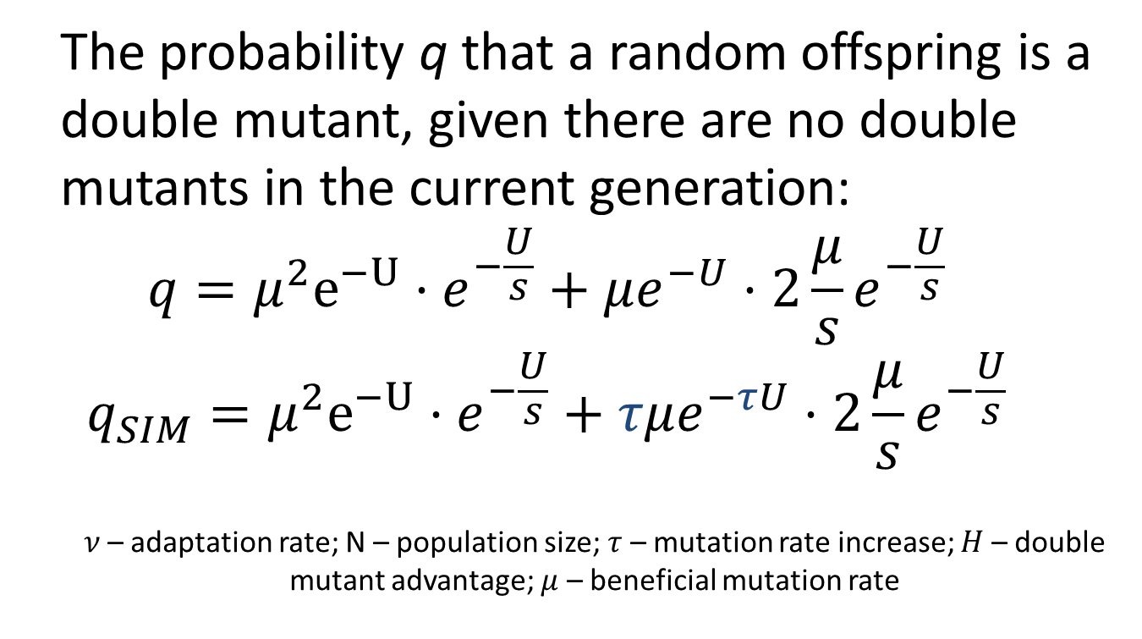
Deterministic model
The probability q that a random offspring is a double mutant, given there are no double mutants in the current generation:
$$q=μ^{2}e^{−U}⋅e^{−\frac{U}{s}}+μe^{−U}⋅2\frac{μ}{s}e^{−\frac{U}{s}}$$
$$q_{SIM}=μ^{2}e^{−U}⋅e^{−\frac{U}{s}}+τμe^{−τU}⋅2\frac{μ}{s}e^{−\frac{U}{s}}$$
$ν$– adaptation rate; N – population size; $τ$ – mutation rate increase; $H$ – double mutant advantage; $μ$ – beneficial mutation rate
Ram & Hadany, PRSB 2014

Slide 35
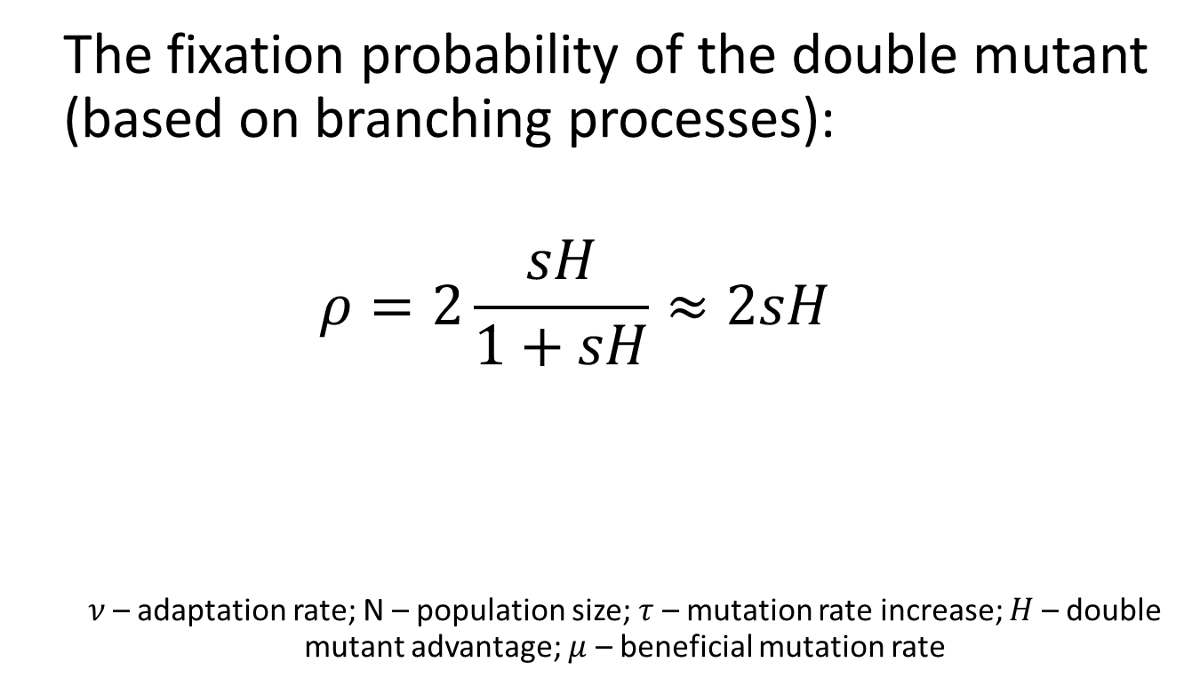
Deterministic model
The fixation probability of the double mutant (based on branching processes):
$$ρ=2\frac{sH}{1+sH}≈2sH$$
$ν$– adaptation rate; N – population size; $τ$ – mutation rate increase; $H$ – double mutant advantage; $μ$ – beneficial mutation rate
Ram & Hadany, PRSB 2014
Ram & Hadany, PRSB 2014

Slide 36
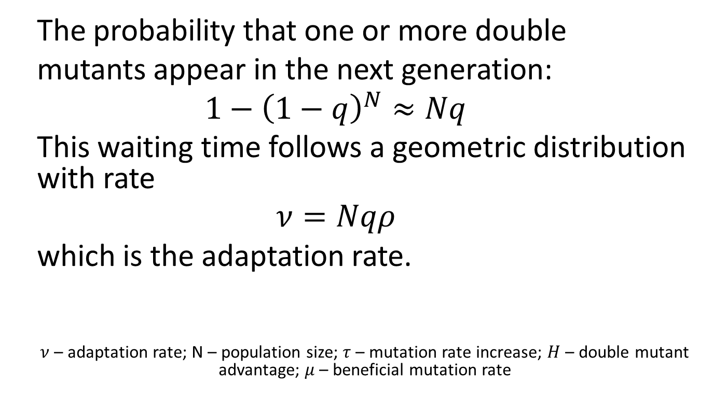
Deterministic model
The probability that one or more double
mutants appear in the next generation:
$$1−{\left(1−q\right)}^{N}≈Nq$$
This waiting time follows a geometric distribution with rate
$$ν=Nqρ$$
which is the adaptation rate.
$ν$– adaptation rate; N – population size; $τ$ – mutation rate increase; $H$ – double mutant advantage; $μ$ – beneficial mutation rate
Ram & Hadany, PRSB 2014

Slide 37
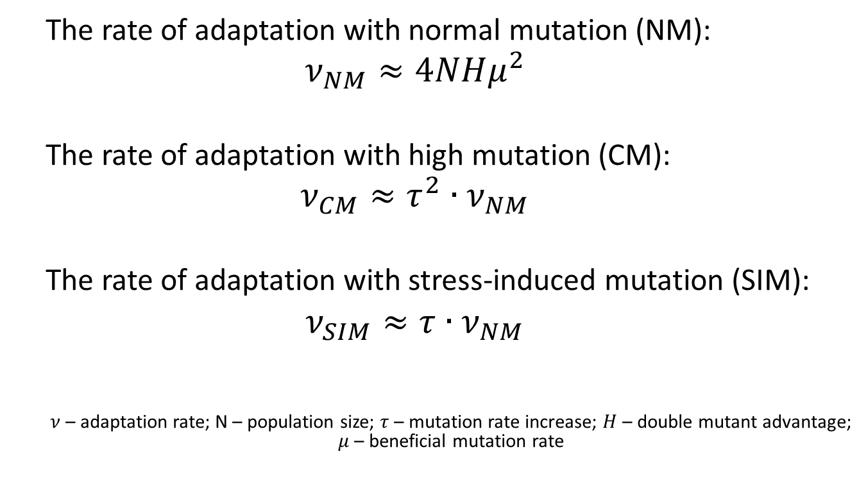
Deterministic results
The rate of adaptation with normal mutation (NM):
$$ν_{NM}≈4NHμ^{2}$$
The rate of adaptation with high mutation (CM):
$$ν_{CM}≈τ^{2}∙ν_{NM}$$
The rate of adaptation with stress-induced mutation (SIM):
$$ν_{SIM}≈τ∙ν_{NM}$$
$ν$– adaptation rate; N – population size; $τ$ – mutation rate increase; $H$ – double mutant advantage; $μ$ – beneficial mutation rate
Ram & Hadany, PRSB 2014

Slide 38
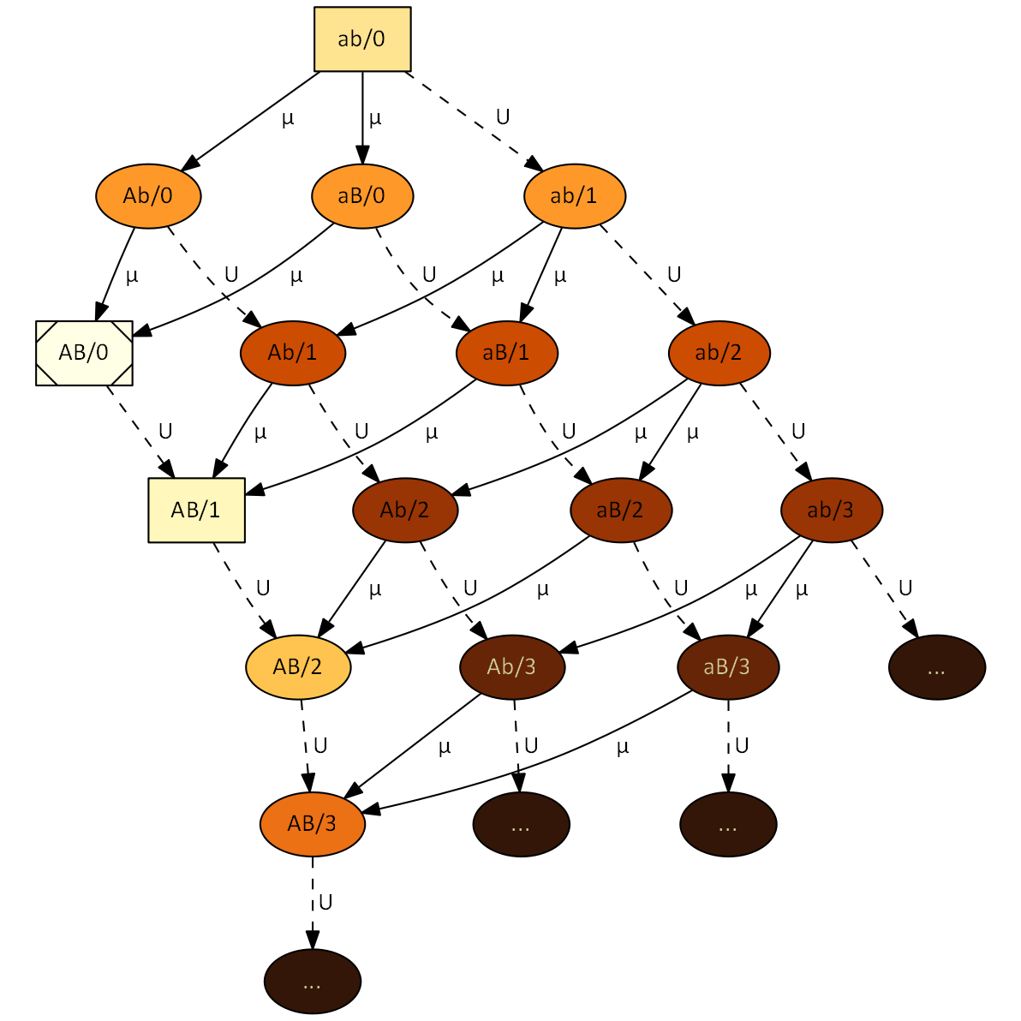


Stochastic model
https://github.com/yoavram/ruggedsim
No MSB assumption
No
fitness
Ram & Hadany, PRSB 2014

Slide 39
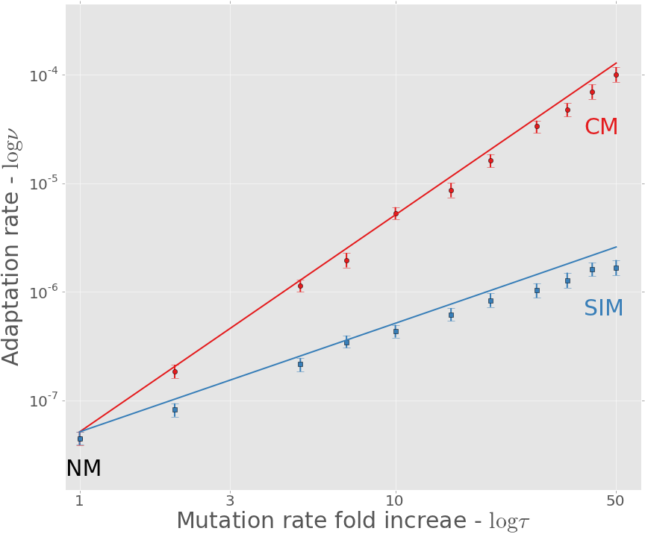
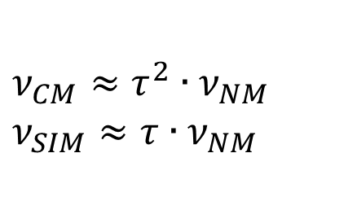
Adaptation rate
$$ν_{CM}≈τ^{2}∙ν_{NM}$$
$$ν_{SIM}≈τ∙ν_{NM}$$
Approximation
Simulation
Ram & Hadany, PRSB 2014

Slide 40
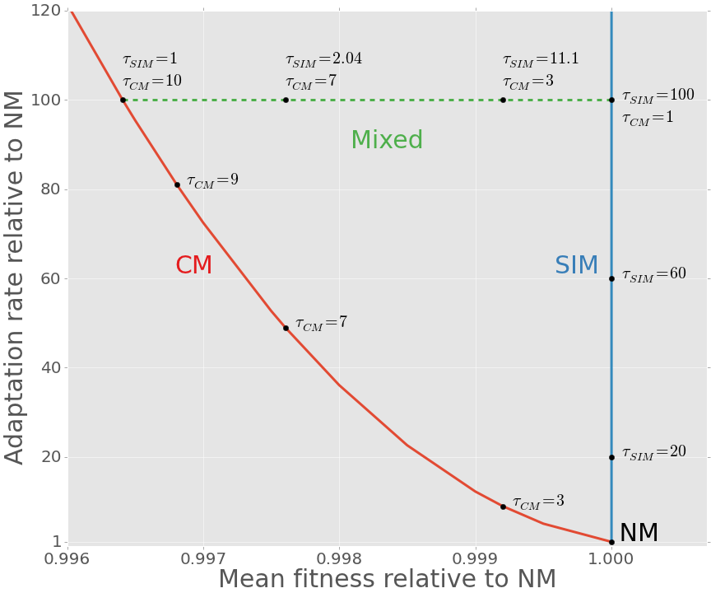
SIM Breaks the adaptability-adaptedness trade-off
Adaptability - Adaptation rate relative to NM
Adaptedness - Mean fitness relative to NM (non-mutator)
Ram & Hadany, PRSB 2014

Slide 41
Conclusion
Evolution of Stress-induced mutagenesis:
SIM can evolve due to 2nd order selection
In constant and changing environments
Ram & Hadany, Evolution 2012
Effects of stress-induced mutagenesis:
SIM increases the adaptation rate without reducing the population mean fitness
Breaks the trade-off between adaptability and adaptedness
Ram & Hadany, PRSB 2014

Slide 42









Acknowledgments
Lilach Hadany
Uri Obolski
Eynat Dellus-Gur
Ariel Guiejman
Eyal Zinger
Marine Veits
Itzhak Khait
Ohad Lewin-Epstein
Ilia Raysin
Israeli Ministry
of Science & Technology
Contact
yoav@yoavram.com
@yoavram
github.com/yoavram
www.yoavram.com
a

